Slide 1
AHA 2014, Getting Started in Digital History Spatial History & hGIS
Kalani Craig
Indiana University, Bloomington
Resources: www.kalanicraig.com/aha-2014-gsdh/
Questions: @kalanicraig or kalani@kalanicraig.com

Slide 2
The “spatial turn”
Geographic Information Systems
the gathering, communicating and analysis of information that is created when you put attributes (population, etc.) into a geospatially referenced space (“onto a map”)
The “h” in hGIS
Axis 1: Attribute
Axis 2: Georeference
Axis 3: Time
The “I” in hGIS
Insights into, and links to, the information BEHIND the map.
The “S” in hGIS
Where are you getting your data? Where are you storing it? How will you present it?
Notes:
Click 1: shows census data from 1870 on 1870s map, plus census data from 2000 on 2000 satellite map.

Slide 3
hGIS concerns
Neogeography & webmapping vs GIS
Maps vs cartograms
Modern maps vs historical maps
Notes:
hGIS vocabulary & its concerns
Neogeography & webmapping vs GIS: maps.google.com
Maps vs cartograms: http://www.google.com/url?sa=t&rct=j&q=&esrc=s&source=web&cd=1&cad=rja&ved=0CCwQFjAA&url=http%3A%2F%2Fwww-personal.umich.edu%2F~mejn%2Felection%2F&ei=anPHUvnjNo7ksASdzIDoDA&usg=AFQjCNGw91iRe3sTj1ZESGgZkDQgPjUhwA&sig2=59z5cBdJtLQU3hG00HfAkQ
Modern maps vs historical maps: See US census 1870 map vs US census 2000 map.

Slide 4
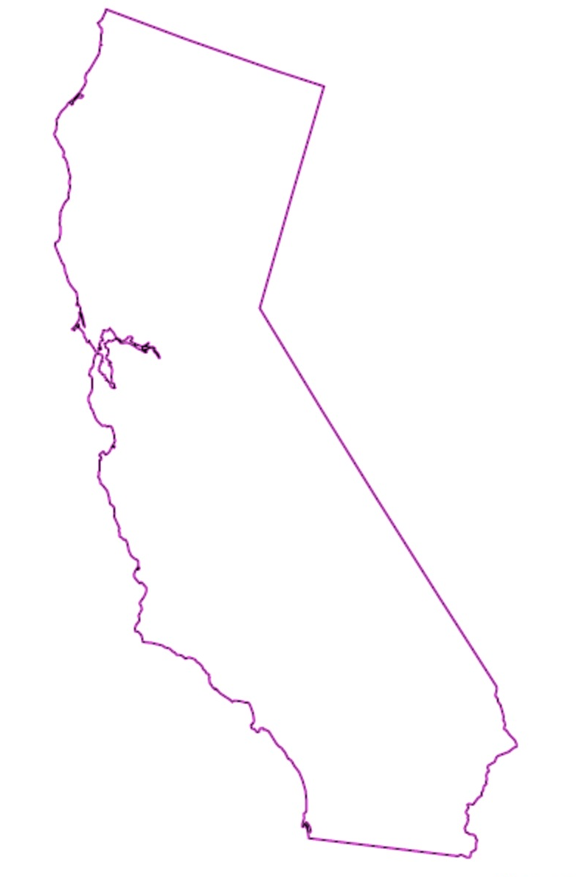
GIS technical vocabulary
Vector data
points, lines and areas
Attribute data
statistical & other information mapped to vector data
Shapefiles & KML
Formats in which vector data and attribute data combine to create map overlays
Shapefile: single vector data type per file
KML: multiple vector data types per file
Layers
Which KML/shapefiles are showing and in what order?

Slide 5
Spatial history in the classroom
The Object
Provide context for—and a better understanding of—medieval sources by recalibrating perceptions of distance and geography in the medieval Mediterranean
A classroom example
Ibn Shaddad’s Third-Crusade world
Digital tool
Stanford ORBIS
Rejected tools: Digital Atlas of Roman Civilization, Google maps
Notes:
ORBIS: http://orbis.stanford.edu
RFO: http://francia.ahlfeldt.se/index.php
Early medieval mapping: http://early-medieval-gis.blogspot.com
DigAtRomMedCiv: http://darmc.harvard.edu/icb/icb.do?keyword=k40248&pageid=icb.page188868

Slide 6
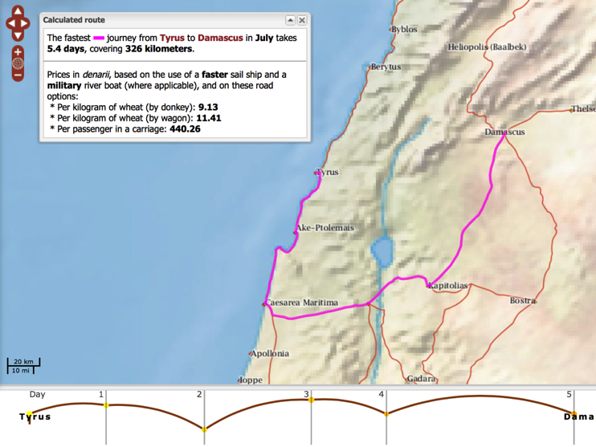
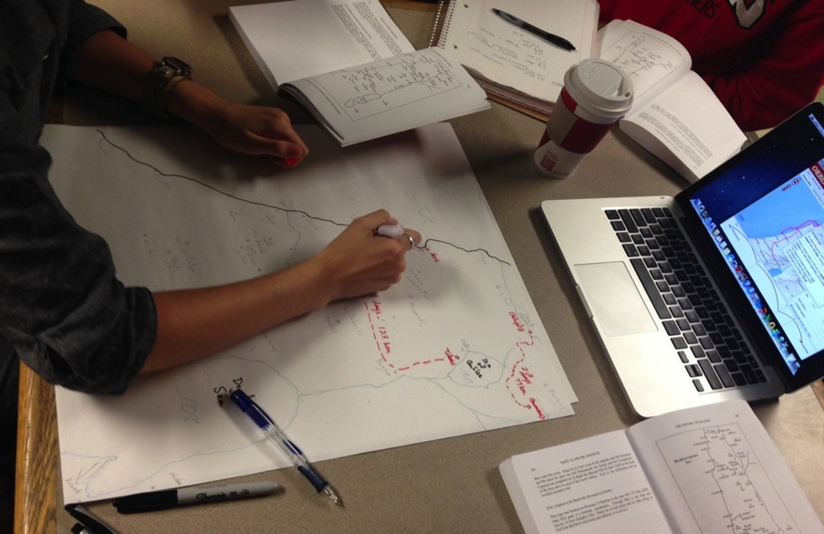
Spatial history: during the exercise

Slide 7
Curating & researching with spatial history
US Census bureau
http://www.census.gov/history/www/reference/maps/population_distribution_over_time.html
New York City GIS project
http://www.nypl.org/blog/2012/06/13/nyc-historical-gis-project
I am it, and it is I (Lovecraft in Providence)
http://lovecraft.neatline.org/neatline-exhibits/show/lovecraft-in-providence/fullscreen
The Age of Exploration: Digital Maps Collection
http://exploration.uoregon.edu
Property Values & Tinker Locations
http://www.stanford.edu/group/spatialhistory/cgi-bin/site/viz.php?id=15&
Notes:
Show Google Fusion Tables and “Visualize” button
Show ArcGIS online: http://kalanicraig.maps.arcgis.com/home/content.html
Show google maps’ KML export
Show KML to shapefile manipulation at http://www.zonums.com/online/kml2shp.php
Show import to ArcGIS online

Slide 8
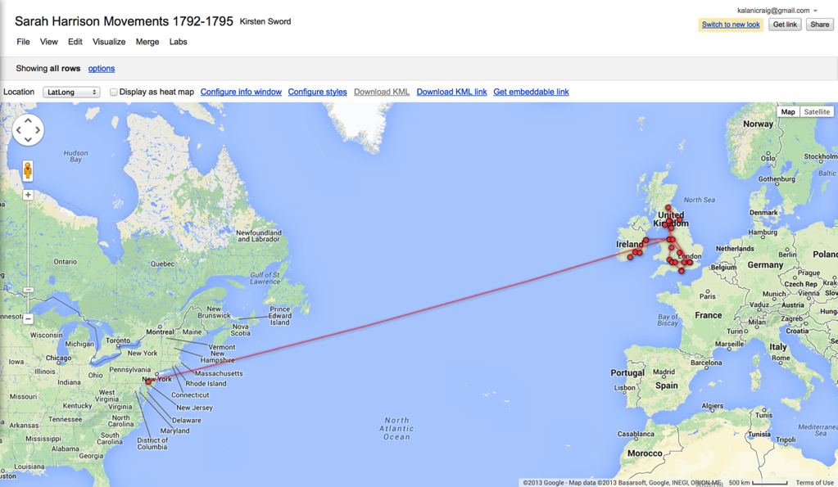
Spatial history tools: Google Fusion Tables
Notes:
Google Fusion Tables (and public data) accessible through Google Drive.
Fusion Tables is a beta product, so sign-up is necessary.
NOTE: the automatic “Visualize” button and the ability to import publicly available data (e.g. population statistics or KML files for common boundaries, borders and locations)

Slide 9
Spatial history tools: Google maps
Notes:
Google maps’ KML export once you’ve saved individual points on a map in “My Places”
KML to shapefile manipulation at http://www.zonums.com/online/kml2shp.php

Slide 10
Spatial history tools: ArcGIS
Notes:
ArcGIS online: http://kalanicraig.maps.arcgis.com/home/content.html
Highlight import to ArcGIS online, including public import options on ArcGIS

Slide 11
Spatial history tools: Google Earth
Notes:
Google Earth most useful for adding polygons.
KML Import under Add -> Network Link.

